Slide 1
5 Steps to a Results Driven Training Systems| How to Create a Profitable, Reproducible, and Turnkey Model That Actually Gets Results

Slide 2
3 Coaching Examples | where are you?
Sole Owner LLC + Head Coach (have full control)
Manager at a Facility (Don’t have final say)
Independent Trainer (no facility)

Slide 3
The Cobbler’s Kids Have No Shoes

Slide 4
The Problems With Most Training Systems
No Training System
No Assessment + On Board Process
No Consistent + Predictable Schedule
No Consistent Service and Delivery
No Built in Education + Learning

Slide 5
Fancy Training Fails + Simplicity Scales
If You Can’t Teach It
You Don’t Know It
If You Don’t Know It
You Can’t Sell It

Slide 6
WHY LISTEN TO US?

Slide 7
Varsity House | By The Numbers 2015 – 2022 Data Subset
2015 – 2021 (7 years)
Annual Adults + Athlete Attendance = 11k +
Adult + Athlete Average Attendance on Monthly Basis = 1,322 - 1500
Coaching Sessions Serviced (All services in hours) = 40,999
Average Monthly Attrition = 3-5%
Average Monthly Retention = 95-97%
Customer Lifetime Value (CLV) = 4.1+ years
Internal VH Study: 250 athletes = 11 blocks, 2.5 years of training, group 8.48% improvement
Internal Adult Training Metrics = 425 adult clients across two facilities, 3.7x a week on average,

Slide 8
STEP 1 | A Training Ideology + System
Goal: Creating an internal process based on your own principles, research, and battle tested methods.
Why is this important: You must have a training system that aligns with your business.

Slide 9
VH Training System Athlete Proven Process
ATHLETES
13 Week Block
Weeks 1-2: Acclimation
Week 3: Test
Weeks 4-6: Developmental
Weeks 7-9: Intensification
Weeks 10-11: Realization
Week 12: Re-Test
Week 13: Hell Week/Challenge Week
Weekly Data Collection
RESOURCE: Teachable Course, Section 2

Slide 10
VH Training System Adult Proven Process
ADULTS
Assessment > Novice or Advanced
# of Days Training Per Week
Training Template Assigned to Individual
Monthly Training Overview + Meeting
Weekly # + Data Recorded
RESOURCE: Teachable Course, Section 2, Adult Proven Process

Slide 12
STEP 2 | Energy Conservation
Goal: Deliver a better product repeatedly over time
Why is this important?: Better results, more profitable product, more sustainable
KEY POINTS
Energy is the #1 commodity: training economy, coaching, and business
Defining your service: world class = better training = less offers
Defining your pricing model: Ryan lee model
Creating your schedule: more from less/consistent service

Slide 13
STEP 2 | Workshop
Write down your service offerings
1
Write down your pricing structure
2
Write down your training schedule
3

Slide 14
The Financially “Fit” Training Model
ASK YOURSELF?
Would you rather service 833 or 291 people at $100/month?
OR
Would you rather service 104/36 people at $800/month?
Who are you going to be able to service better + get results?

Slide 15
SERVICE | clarity
EXAMPLE Service Offerings:
ADULT
Semi-private Training
Vfit (class training)
Private Training
ATHLETE
2x a Week Strength or Speed
5x Unlimited (strength, speed, and recovery day)
Who are you going to be able to service better + get results?

Slide 16
PRICING | more per hour
EXAMPLE Service Offerings:
ADULT
Semi-private Training (1-4x a week)
1x = $299
2x = $399
3x = $499
4x = $599
Vfit (class training) ($220)
Private Training ($1000 for 10 sessions)
ATHLETE
2x a Week Strength or Speed ($225)
5x Unlimited (strength, speed, and recovery day) ($275)

Slide 17
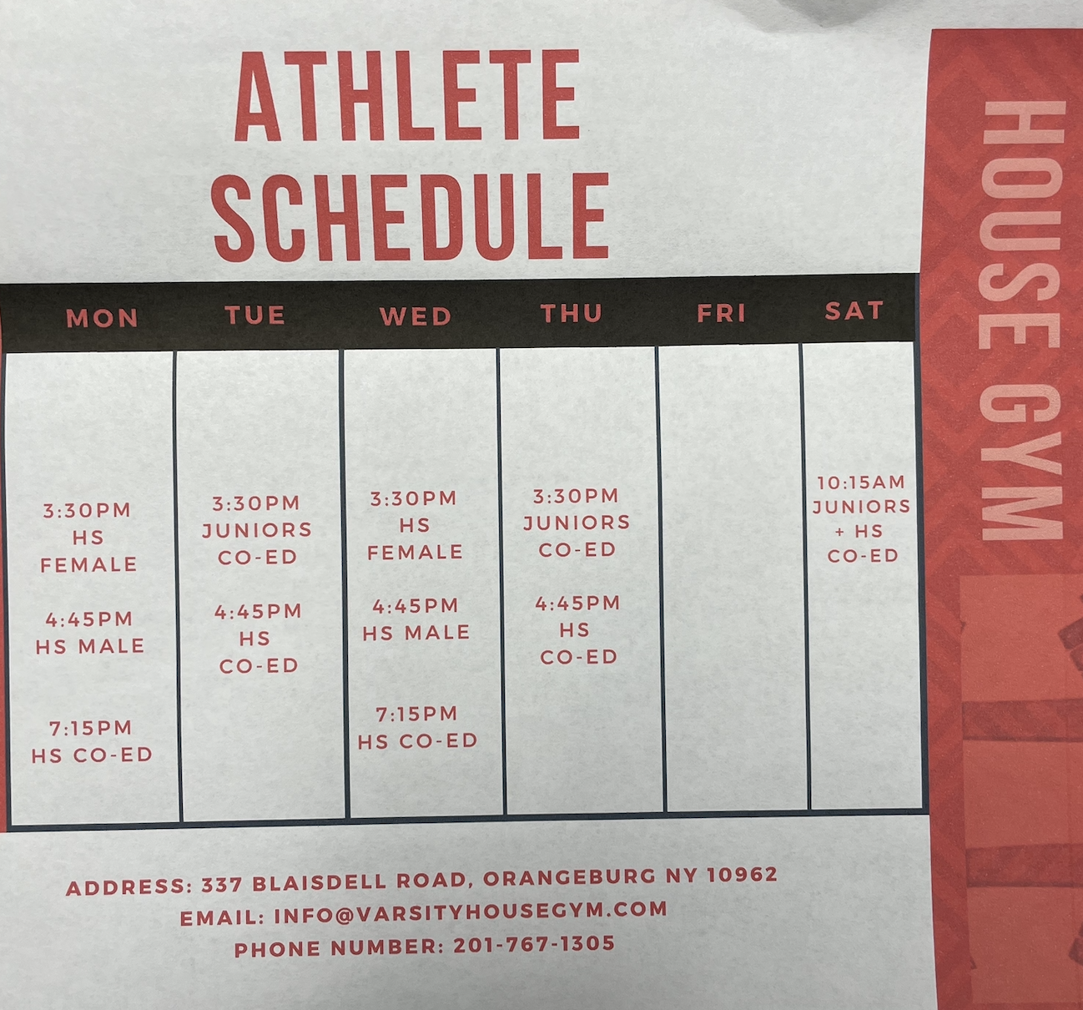
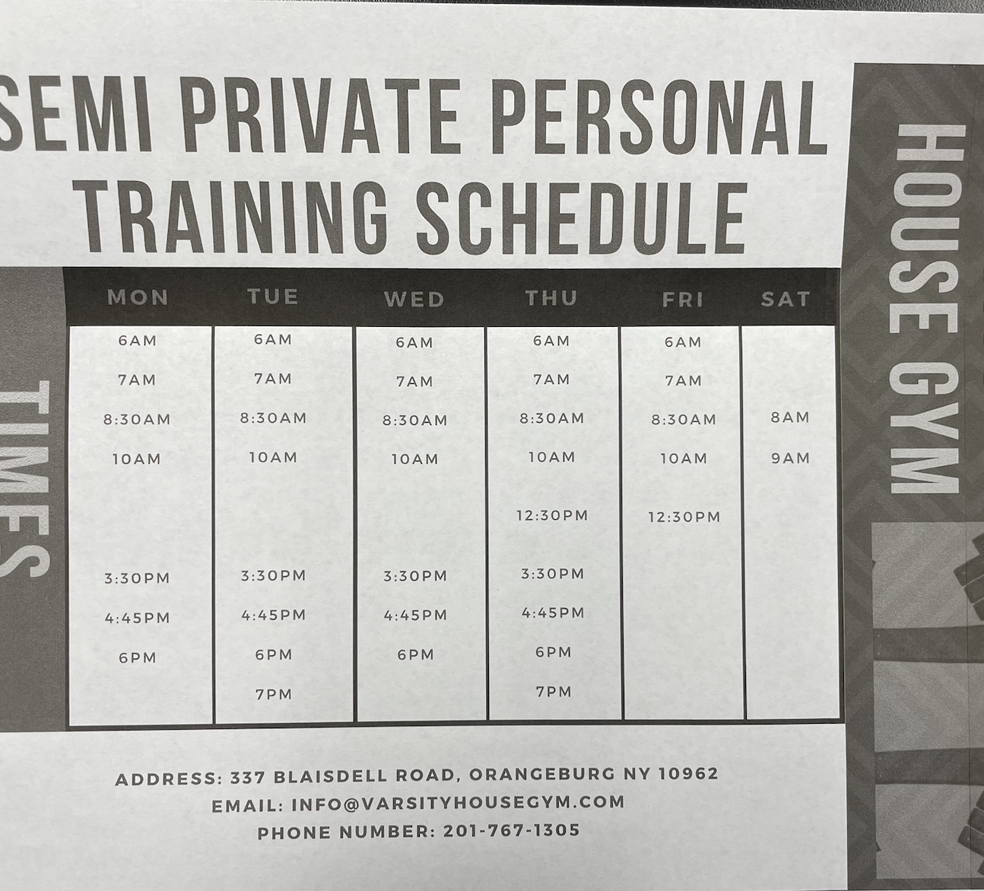
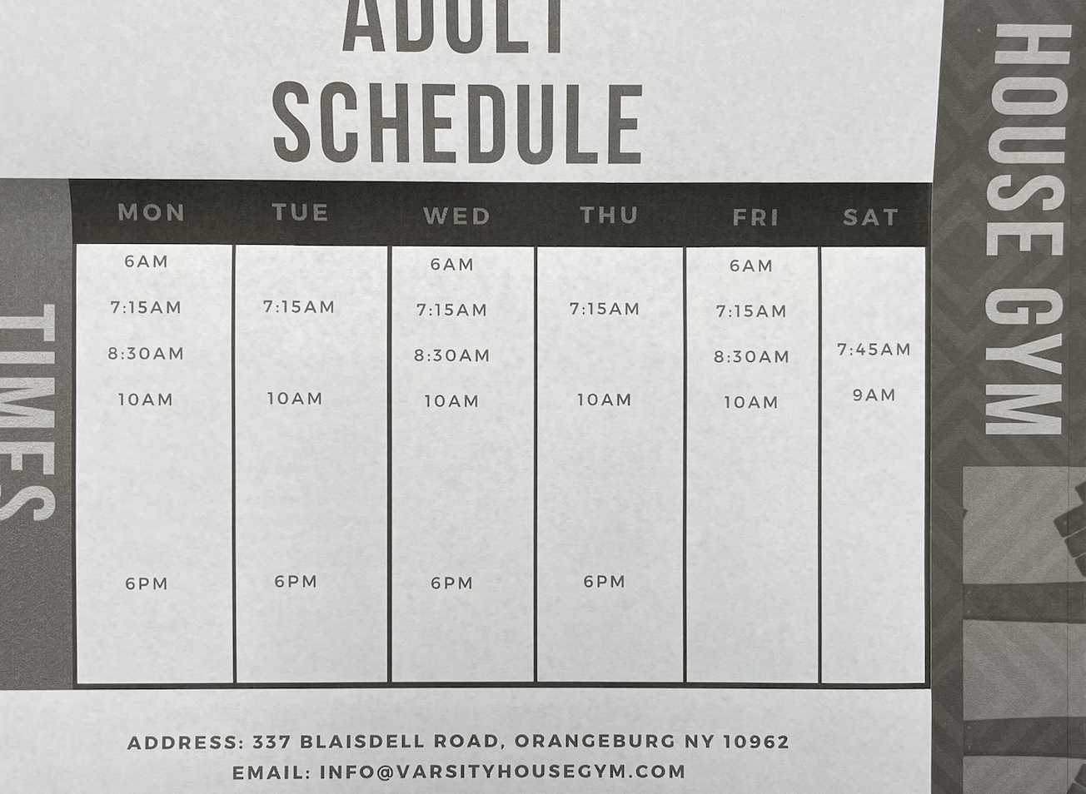
SCHEDULE | more from less
Which is easier to service?
100 weekly sessions (all services)?
65 weekly sessions (all services)?
More coaching energy = better sessions
Less cost of business
Increase $ value per session
EQUATION = Less ppl x more $ in Less time = Less cost of business energy + $

Slide 18
STEP 3 | Front End Offer: Assessment + On Board
Goal: Create a GREAT 1st impression, identify goals, access individual, kickstart training/service process
Why is this important:
KEY POINTS
Undersell + OVER deliver
How do you onboard new individuals?
What does the assessment look like, onboard, and what are the touchpoints?

Slide 19
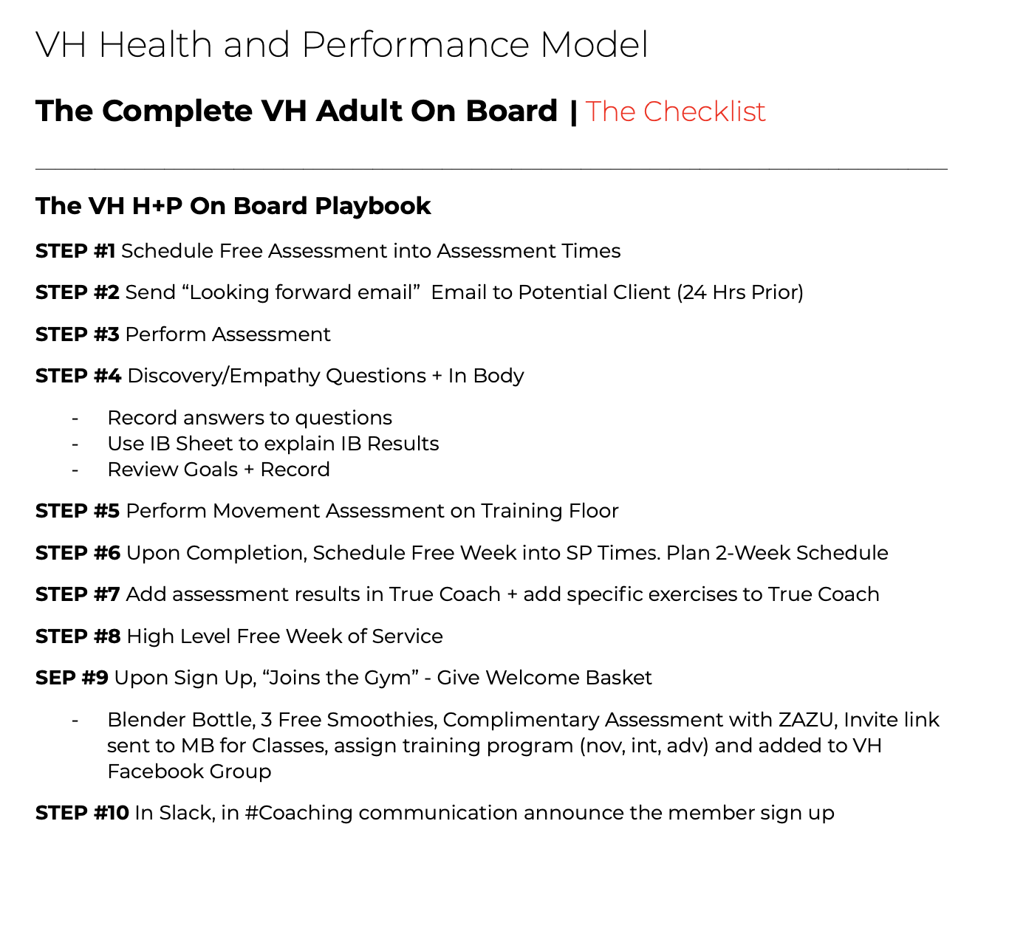
The On Board| be more memorable…
Questions to Consider:
Does your assessment fit your training model?
How much time, how many can you perform in a day, week, month?
Is the information your collecting relevant?
What are the touchpoints?
STEP 1: Goal Setting (initial sit down)
STEP 2: Movement + Training Eval (training floor)
STEP 3: Review Goals (second sit down)
STEP 4: Close (1/2 off, 10%, regular price)
STEP: On Board (Slack, TC, FB Community group)

Slide 20
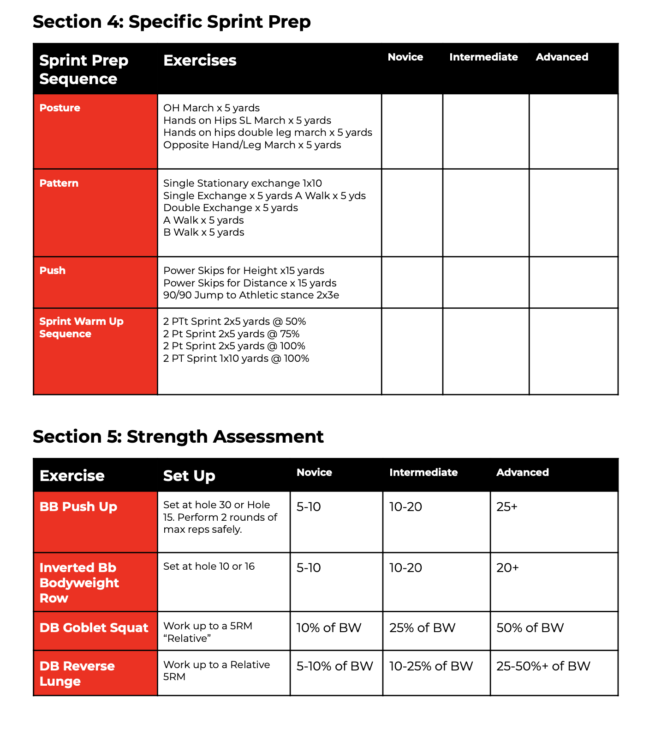
The Assessment| gather the right information
Questions to Consider:
HAS to fit your training model + process
Acclimate individual to “flow of gym”
Identify aliments, pathologies, injury/medical history
Include personal information
STEP 1: Movement (stationary)
STEP 2: Movement (Compensations)
STEP 3* Speed + Power (for athletes)
STEP 3: Training (ability to work)
STEP 4: Cardiovascular (work capacity)

Slide 21
STOP HERE. Intermission.

Slide 22
INTERMISSION
A. This is where you should pause + map out the above process
B. Take time to do this before moving on to the following sections

Slide 23
STEP 4 | Creating Consistent Service + Delivery
Goal: Identify how to track service + delivery
Why is this important: It takes 10x more effort to acquire a new client than keep the ones you have.
KEY POINTS
Metrics: Attrition, Retention, Check In’s and Reviews
Identify Churn Rate + Attrition
Defining the service standard, the process, the communication
Volume x time = skill

Slide 24
Know Your Numbers| Attrition + Retention
The #1 Way to Predict Client Attrition…
Attendance.
INDUSTRY GOLD STANDARD
3-5% attrition rate
95-95% retention rate
Attrition = # of clients loss / # of current clients at start of month x 100 = ________________
EX: 7 clients leave / 50 total clients at start of June
= 14% churn rate
CHECK IN’S
If you have 50 clients
You’re getting 25 check ins a week
50% of clients are not attending

Slide 25
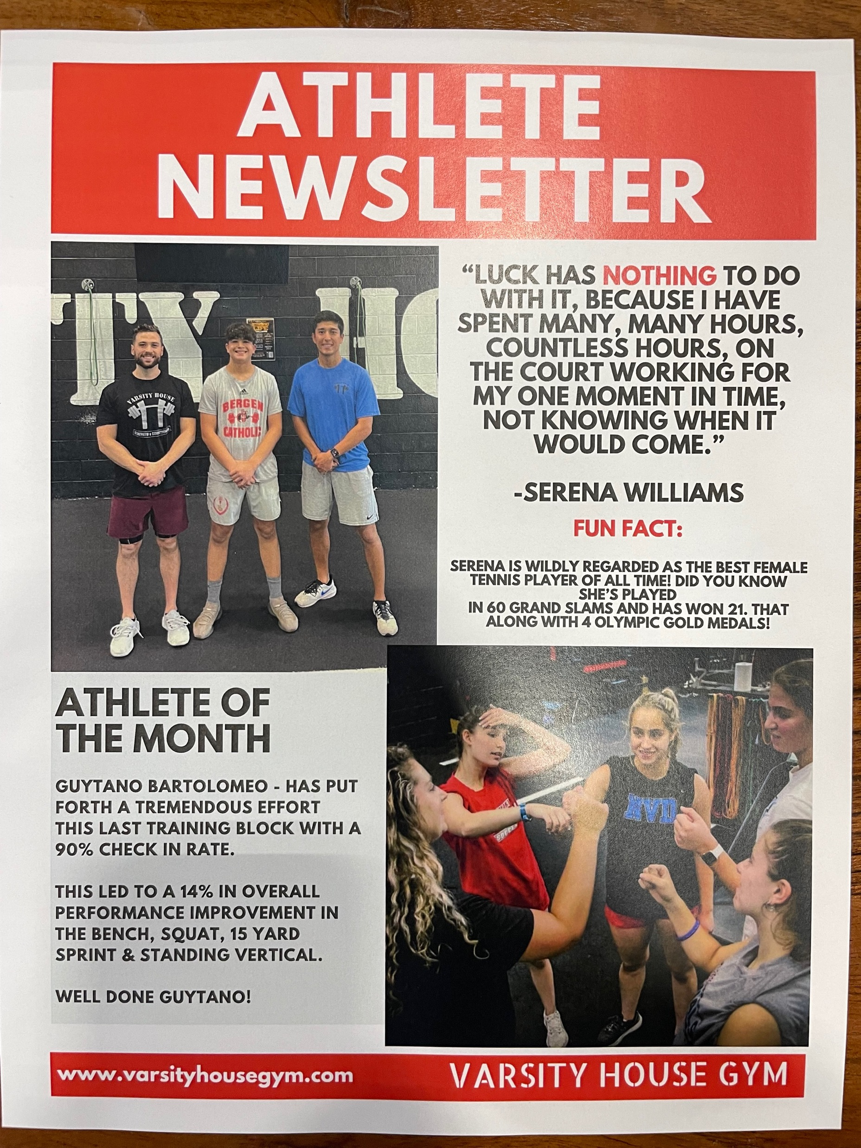
Client Experience| increase your retention %
PART 1 High Level Coaching
What’s the standard?
PART 2 Community Management
Who is responsible for client experience?
Adult Tactics
Athlete Tactics

Slide 26
STEP 4 | Implementation + Follow Up
Goal: Consistency.
Why is this important: Lack of consistency = lack of service = lack of results/experience = no customers = no business.
KEY POINTS
DefIdentify Churn Rate + Attrition
Defining the service standard, the process, the communication
Volume x time = skill

Slide 27
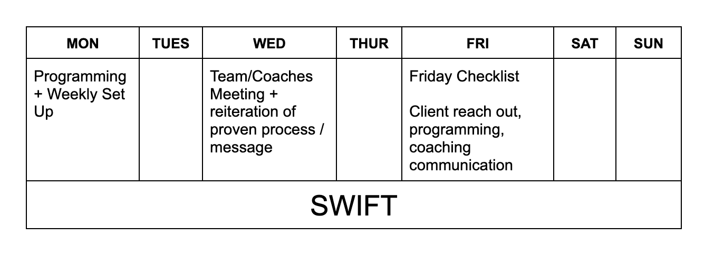
Dialing in Your Frequency | communication
Defining Your Service Standard
Defining Your Training Process
Defining Communication

Slide 28
Dialing in Your Frequency | communication
Defining Your Service Standard
Defining Your Training Process
Defining Communication

Slide 29
Q+A

