Slide 1
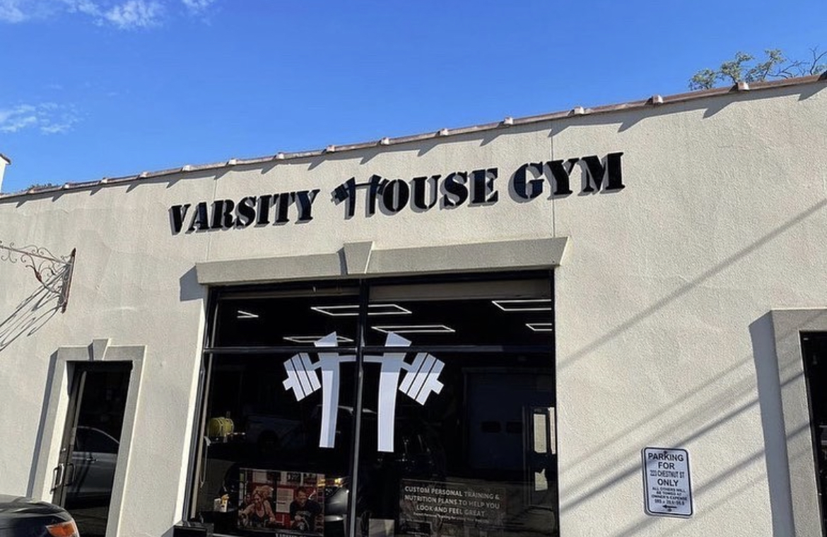
Spring + Summer Marketing for Gyms by Dan Goodman

Slide 2
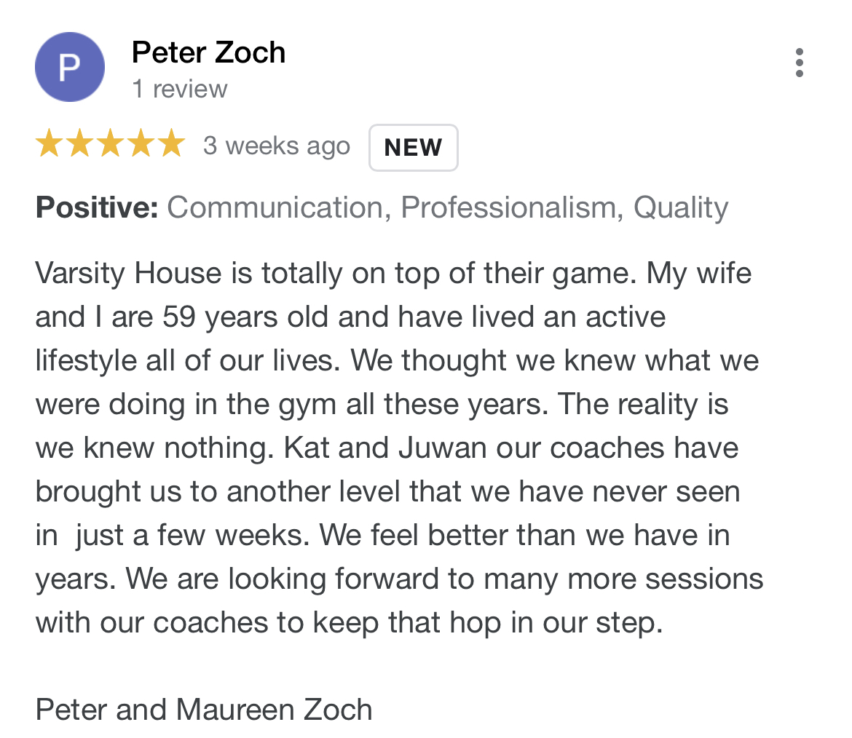
75% of small businesses don’t make it 10 years
Reasons:
Run out of cash
Burn out
No team development
Don’t understand the client Lifecyle (Attrition)
Inability to consistently market their product

Slide 3
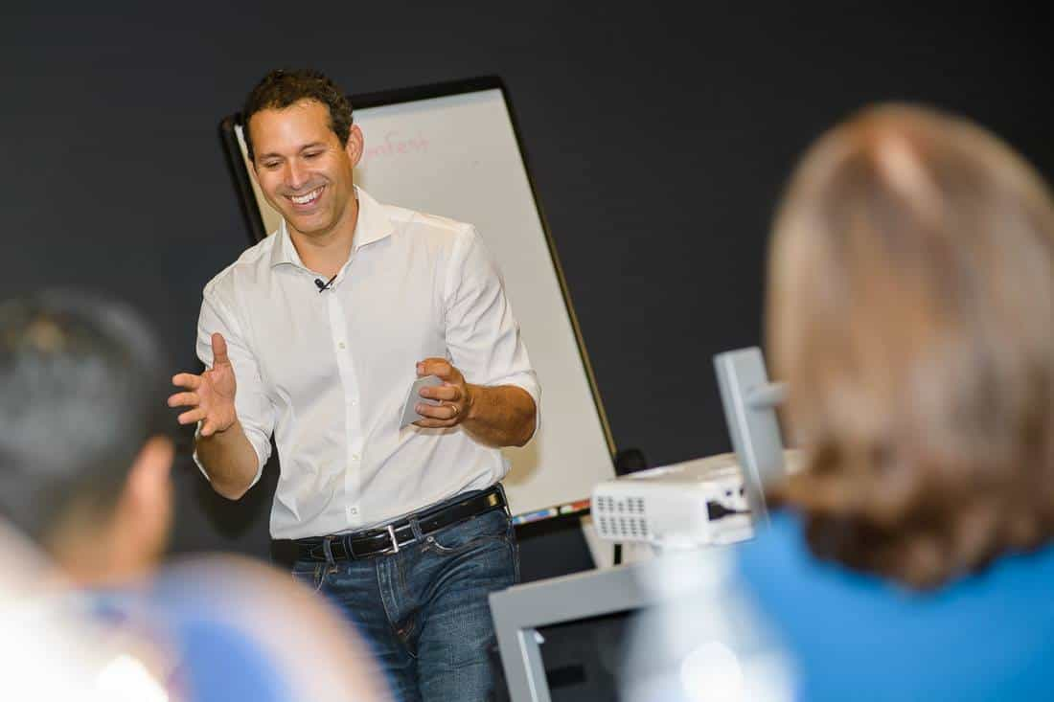
The King of Consistency
What’s on your calendar for marketing this week?
Marketing needs to feel like brushing your teeth.
Automatics win!

Slide 4
Before the “Initiatives”
Do you have time on your weekly calendar to do marketing/sales?
What are you committed to producing?
Does your website suck?
Have you tried any direct response opportunities?
- Nutrition seminar
Paid speed clinics
Additional opening at a certain time
New program
Asking people if they want to increase their training frequency
- When was the last time you reached out to a client that is no longer training at your gym?

Slide 5
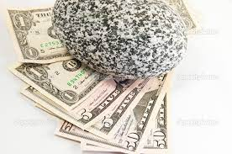
Internal #1
Summer Shred/Slim down for members - $99
Athlete Printed Newsletters (Mailed to all current and former athletes w/QR code to free session)
Athlete Parent Appreciation
6wt increased frequency close outs!
Social proofing closing of 6wt!
Anchored bring a friends (Guest coach, yoga session, offsite workout)
Sale on winter products (Get it off the shelves!)
August attendance challenge
Google Review Campaign

Slide 6
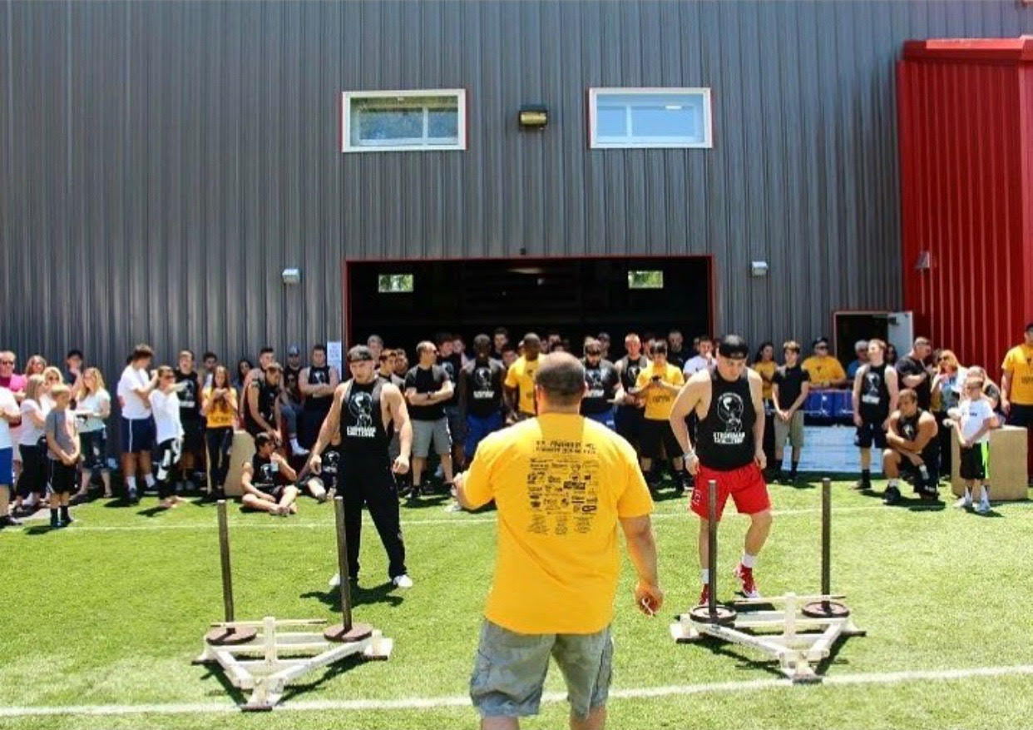
Referral #2
Paid referral system
Paid google reviews (for a month)
Black card campaign
Reactivation campaigns
Client BBQ
Charity event (Strongman)

Slide 7
External #3
Summer Shred/Slim down - $297
Athlete Open Enrollment
Athlete sports camp
Athlete Printed Newsletters (Mailed to all current and former athletes w/QR code to free session)
Running wellness initiative for Chamber of commerce (FREE)
Do a public speaking event (School, local podcast, write an article for the local paper)
6wt “Energy Usage” report. (Mailer to all active members/former clients)
Athlete scholarship – Done as sweepstakes
Nutrition book (Printed/E-Book)
Ad spend – (Only if you’re willing to spend $1000 per month minimum)

