Slide 1
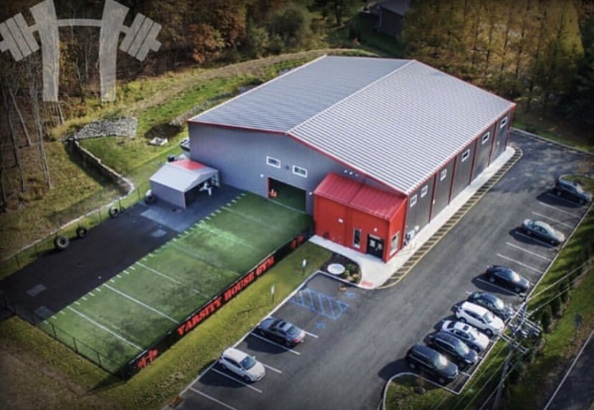
Team > Individual
By Dan Goodman

Slide 2
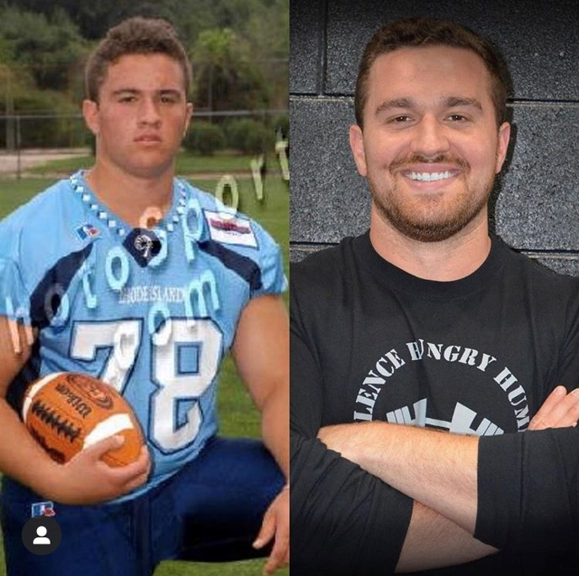
Why should you listen to me?
5 team Members that have been of our crew for 5+ years.
3 team members that have been part of the crew for 10+ year’s.
Varsity House Gym has awarded two owners the sought after entrepreneurial dream of time and financial security.

Slide 3
Two greatest business multipliers…
Marketing & Leadership
The best team member you have or ever had? If you’ve never had a team member what type of person or role would best help you grow right now?
How would your business change with another person like that?

Slide 4
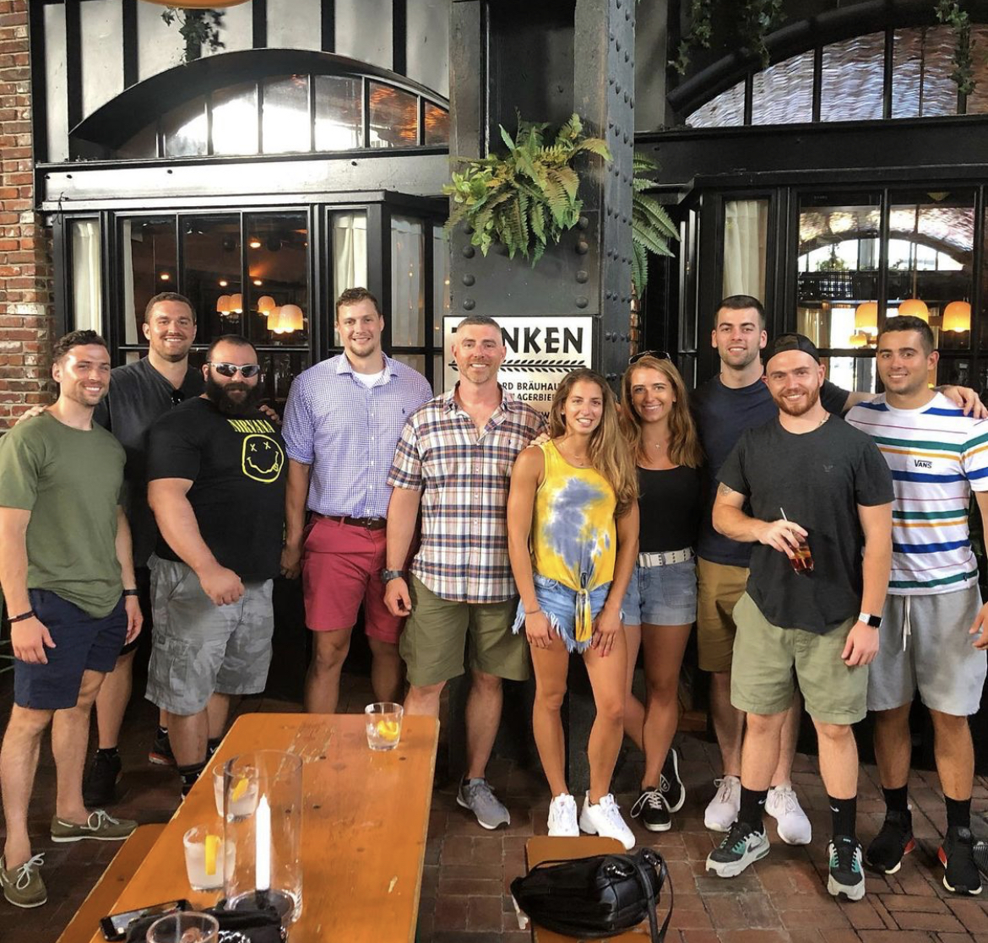
Driving culture
“When leaders fail to empower others, it is usually due to three main reasons:
1. Desire for Job Security
2. Resistance to Change
3. Lack of Self-Worth."
- John C. Maxwell

Slide 5

Systems run business – People run systems.
You will have people move on.
You will have to fire people.
You will not be liked by all.
Leverage can only be gained with systems.
These lectures are useless if no action is taken.

Slide 6
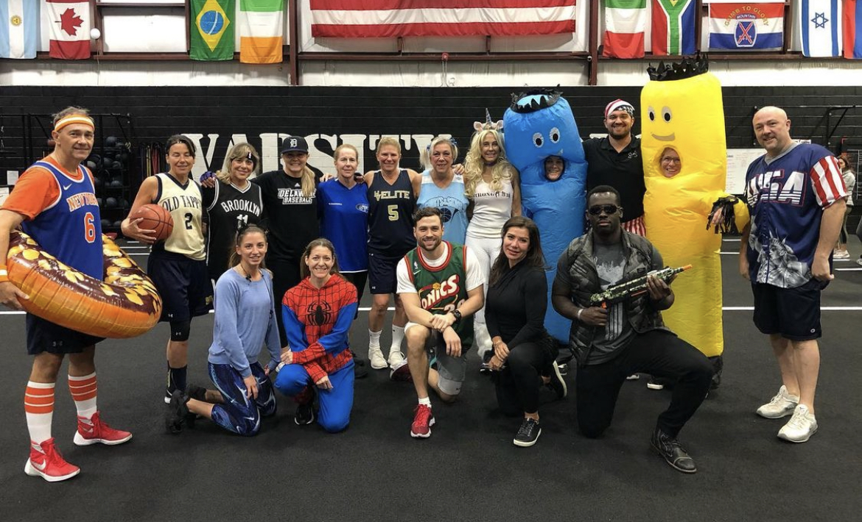
C.R.O.
Chief – Reminding – Officer
4 Pillars of Success:
GSFC
Career Trajectory
Empathy
Celebration

Slide 7
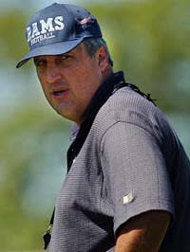
Give a Shit Factor of Concentration (GSFC)
You have to CARE!
Team members are your NUMBER 1 clients.
There is no greater return on investment.
Be the Coach that you wish you had.
It’s easy to care when you have systems to remove the noise…

Slide 8

Career Trajectory
Good communication = good business.
Well documented company vision & values.
Depth chart.
$500 continued education stipend.
KRA’s + KPI’s (Less Assumption).
401k/PTO/Health Benefits
Team members crave consistency and security!

Slide 9
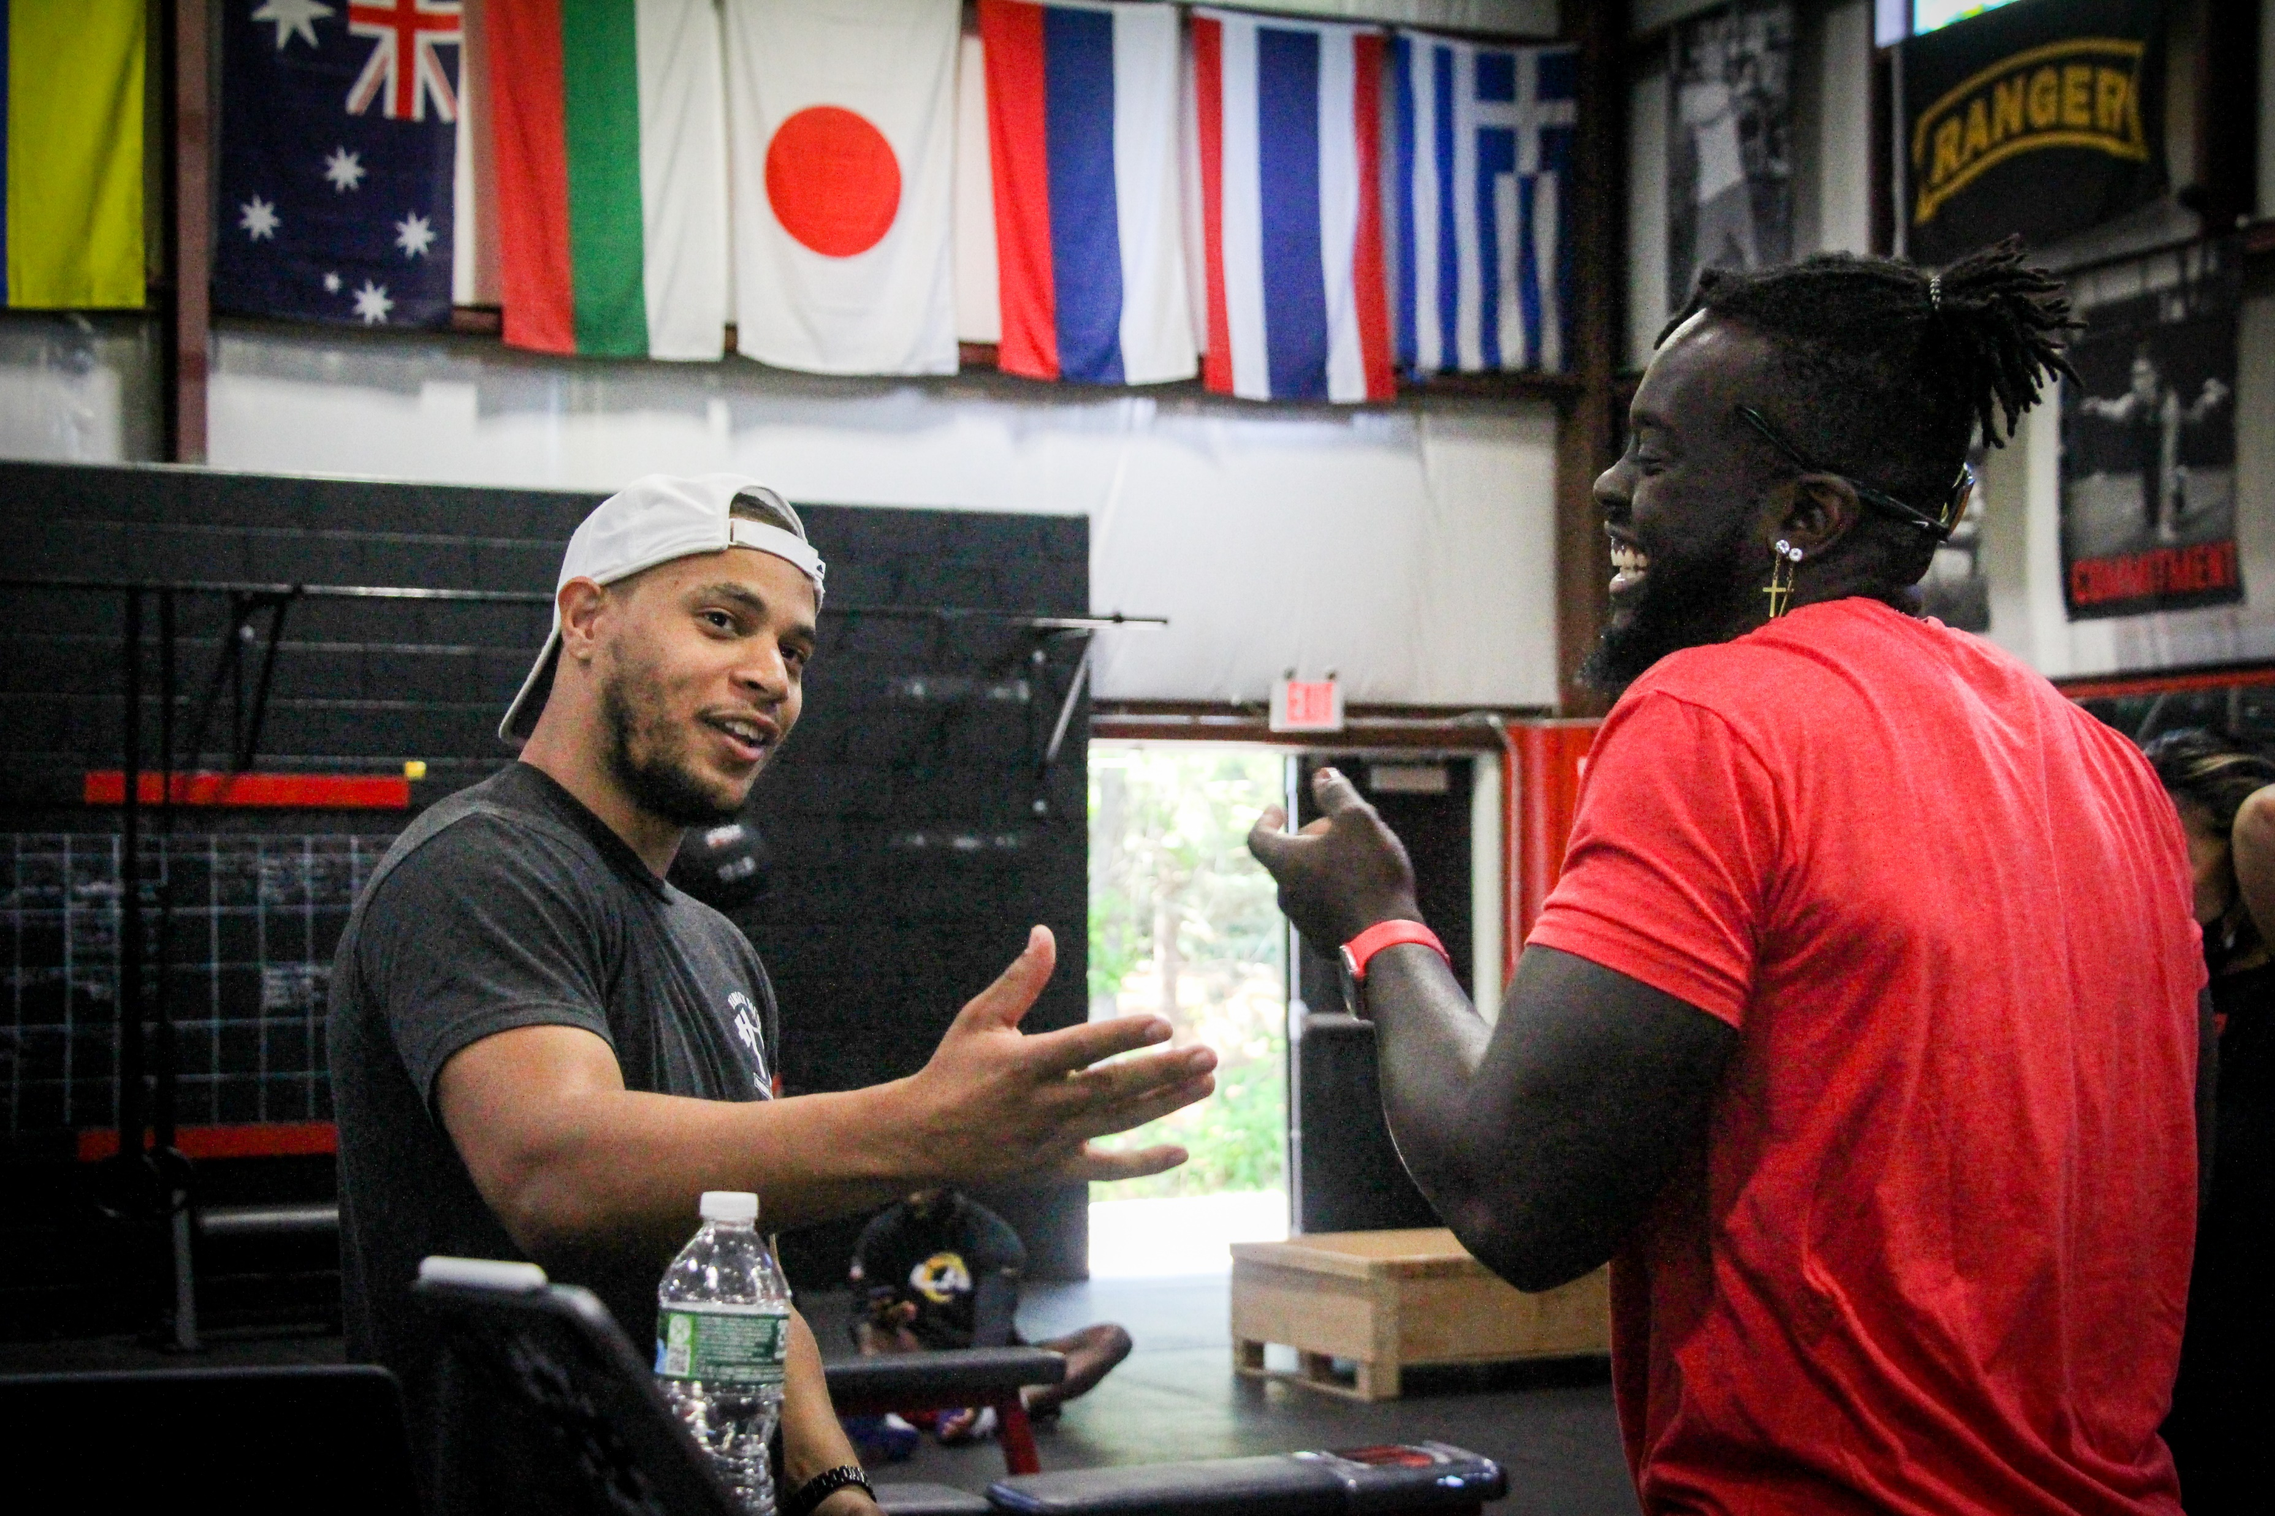
Empathy
Shit Happens – hedge these situations…
PTO.
Flexible scheduling.
Communication Channels.
Schedule Education days.
Anchored advisory meetings, coaches meetings and town halls.
Listen.

Slide 10
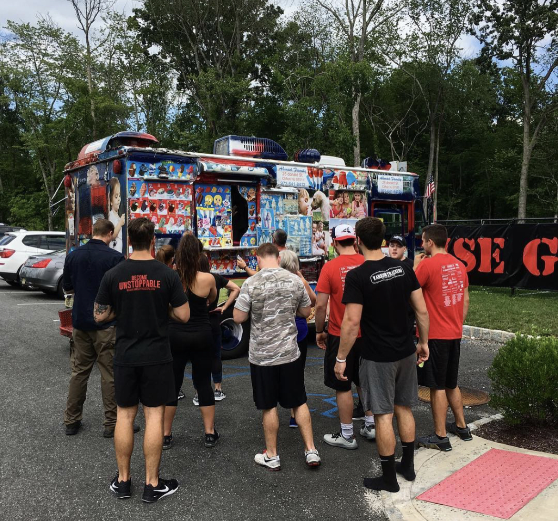
Celebration
Recognition… All-American Effect.
Discretionary spend.
Quick hit wins.
Quarter end parties.
Company wide team days.
A bonus half day.
Don’t forget the snow day effect!

Slide 11
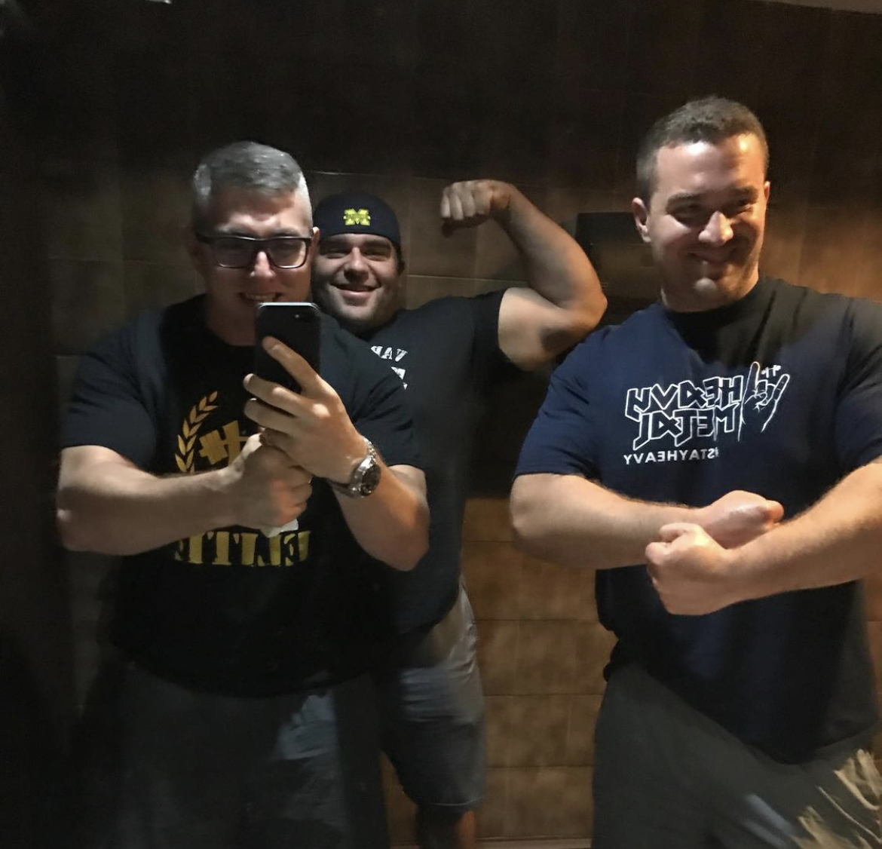
Now what?
1. Filling your time with actionable team member coaching hours.
2. Non-Negotiable leadership hours.
3. Understanding YOUR role.
Strategy, LMA, trains on time, glue, vision, big relationships.
If its memorable its repeatable for you and the team.

Slide 12
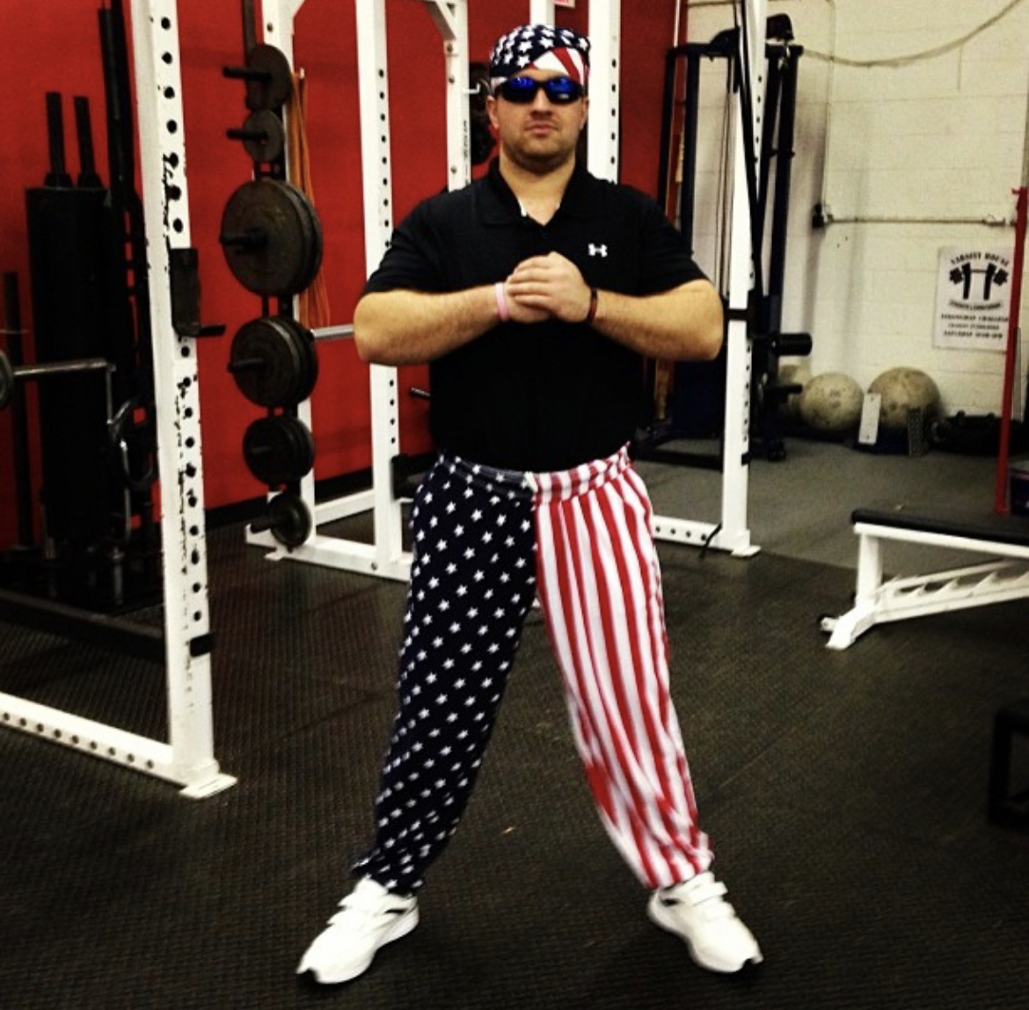
Questions?

